Slide 1
Coursera: Battle of the Neighborhood
Alejandro de la Garza Musi

Slide 2
Index
Introduction
Problem & Solution
Methodology
Results

Slide 3
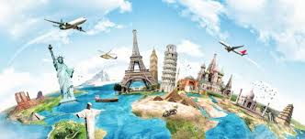
Introduction
In this new age of globalization & the opening of worldwide opportunities for any talented individual generates a new reality that is: that one person might work in different cities or even countries in their lifetime (For this example we will be using New York & Toronto).
The Opportunity to work around the World is now an open door to anyone who wishes to.

Slide 4

Problem &Solution
People would probably like to shift a location that resembles their current lifestyle and that implies that he/she would like to have coffee shops, gyms, libraries, malls or specialized stores.
What I want to provide: A way for a person to know which neighborhoods have similar services, amenities or store so that a person shifts within the city or from one city to another city her/his current way of life can be maintained as much as possible (If that person wishes it of course)

Slide 5


Methodology
I will be using the borough/neighborhood data of two cities (NY & Toronto)
I will find the nearby venues to each borough and neighborhood & pair them in both cities. With the Foursquare API get to see any nearby venues.

Slide 6
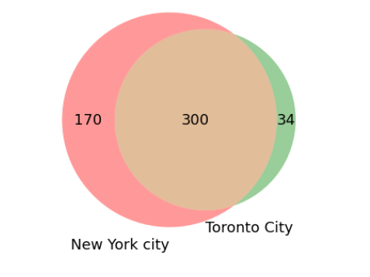
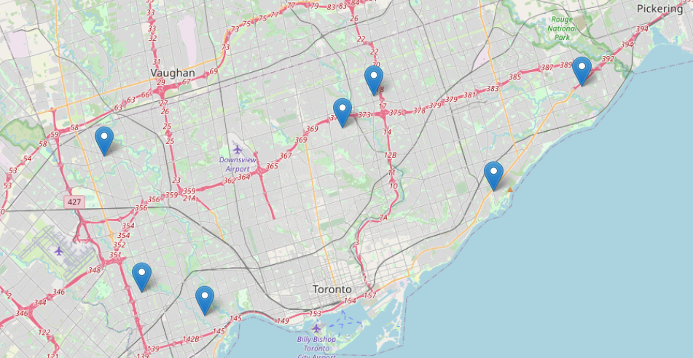
Results
We found that the Cities shared 300 Venues.
Yet we implemented a way that you can compare your current borough/neighborhood to the top 7 in the other city: The example below is from Staten Island, St. George, New York & here are the borough is Toronto with most similarities.

Slide 7
Conclusion
This model can be implemented within any city. This will help to find a suitable place for people. This will give most similar borough and neighborhoods. Helping others to do smart decision when moving to another city to work in a fast & efficient way with real data.

